Slide 1


Linear Algebra in Data Science
Linear algebra is a fundamental tool used in data science to analyze and manipulate data. By understanding its concepts and applications, we can unlock powerful insights and solve complex problems.

Slide 2
Importance of Linear Algebra in Data Science
Data Manipulation
Model Building
Linear algebra enables us to perform efficient and scalable operations on large datasets, such as matrix multiplication and vector transformations.
Linear algebra provides the foundation for building robust predictive models, including linear regression, principal component analysis, and more.
Optimization
Machine Learning
Optimization techniques heavily rely on linear algebra for solving complex optimization problems and finding optimal solutions.
Machine learning algorithms, such as support vector machines and neural networks, are rooted in linear algebra concepts.

Slide 3
Basics of Linear Algebra: Vectors and Matrices
1
Vectors
2
Matrices
Vectors are fundamental entities in linear algebra that represent magnitude and direction. They are used for representing features, observations, and variables in data science.
Matrices are rectangular arrays of numbers, consisting of rows and columns. They are used for performing mathematical operations on data, such as transformations and projections.

Slide 4
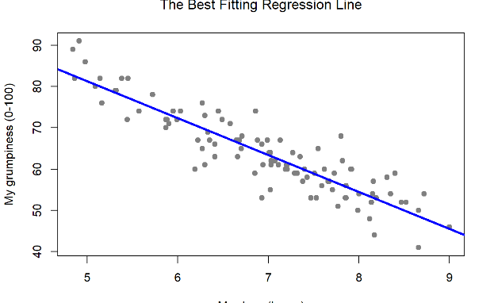
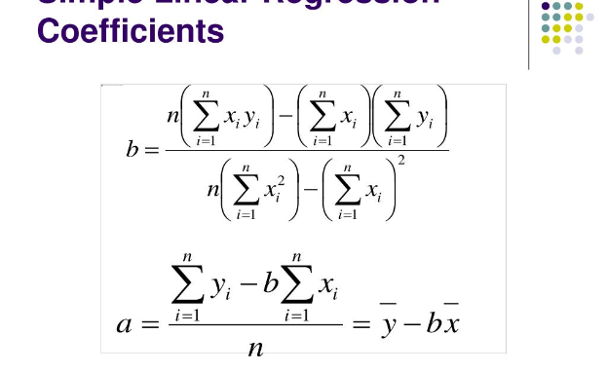
Example 1: Linear Regression
Modeling Relationships
Coefficient Interpretation
Linear regression uses linear algebra to model the relationship between independent variables and a target variable. It estimates the coefficients that best fit the data.
By interpreting the coefficients obtained from linear regression, we can understand the impact of each independent variable on the target variable.

Slide 5
Example 2: Principal Component Analysis (PCA)
1
Dimensionality Reduction
PCA utilizes linear algebra to reduce the dimensionality of high-dimensional datasets by finding the eigenvectors and eigenvalues that capture the most variance.
Data Visualization
2
By projecting data onto a lower-dimensional subspace defined by eigenvectors, PCA helps visualize and understand the underlying structure of complex datasets.

Slide 6

Conclusion: Understanding Linear Algebra in Data Science
Key Takeaways
Improved Problem Solving
Linear algebra is a powerful tool for data scientists to manipulate, model, and analyze data. It underpins various algorithms and techniques used in the field.
By mastering linear algebra concepts, data scientists can develop more efficient algorithms, make better decisions, and solve complex problems in diverse domains.

